Slide 1
BUS RESERVATION SYSTEM
IN COMPUTERISED FORM

Slide 2
SONAHANG RAI KAMAL SUNAR SAURAV SHRESTHA
PREPARED BY

Slide 3
PROJECT INTRODUCTION
Bus reservation system is a systematic way of recording the information of the customer by the traveling agencies company.
Simply we can define it as recording passenger’s information.
The purpose of this system is to make the data information handling easier.
It also ensures protection of the data’s.

Slide 4
OBJECTIVES
1. To make the booking process standard.
2. To reduces the error during the reservation process.
3. To store the passenger’s data safely so that it can be retrieved easily during the needed time.

Slide 5
Demerits of the file based reservation system
The paper works were done so there was a risk of the losing the data.
If the data's are to be shared than the entire data copying process would be time consuming.
The data's could not be stored for the longer period.
It consumes more time and space.

Slide 6
Merits of the new computerized system
The data are more secure than the file based reserving system.
The data's can be stored for the longer period of the time.
The data's can be shared easily.
The modification of the data’s are not a big deal.

Slide 7
Technologies recommendation
Hardware
Software
Monitor
Keyboard
Hard drive
RAM
Processor
Turbo-c compiler
Windows xp or later

Slide 8
OVERVIEW
It is a simple c program to store the passenger data's in the files for effective use.
It helps the fast retrieval of the stored data.
It makes the data modification easier.
It can be handled by less skilled human power also.

Slide 9
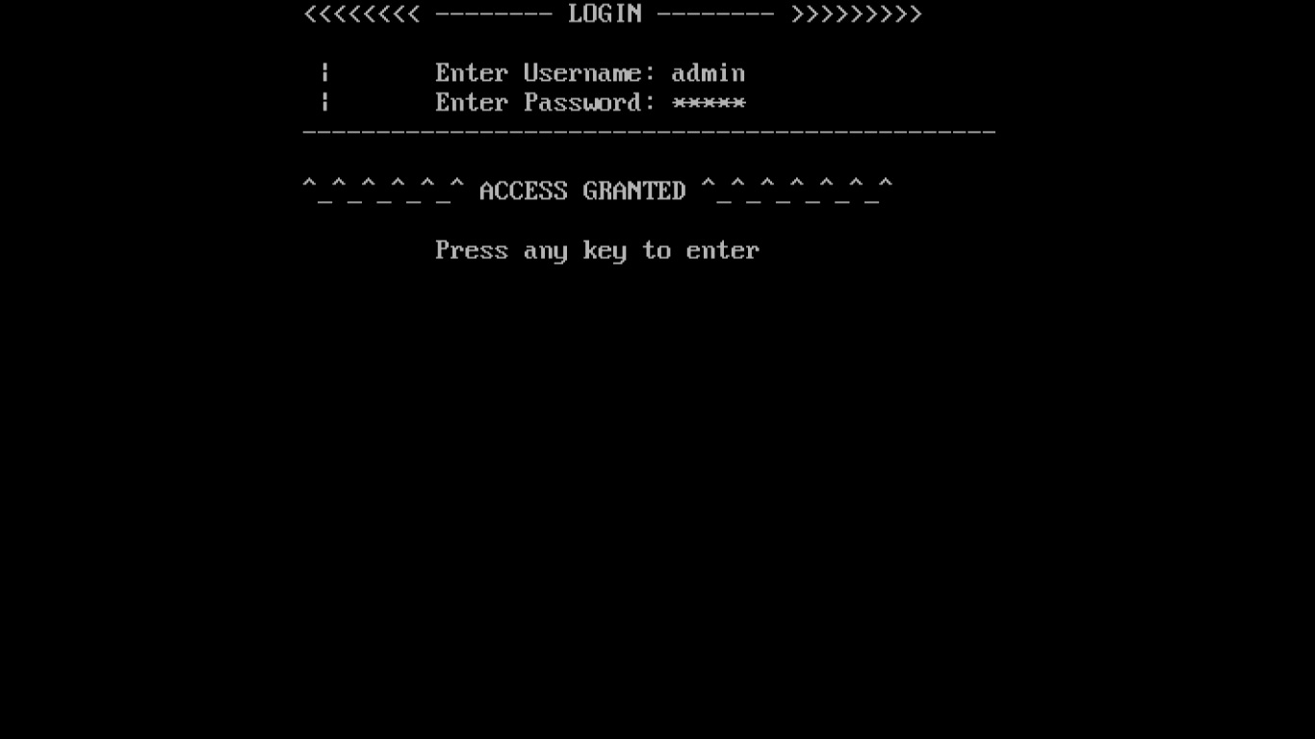
Screenshots
The first screen during run time.

Slide 10
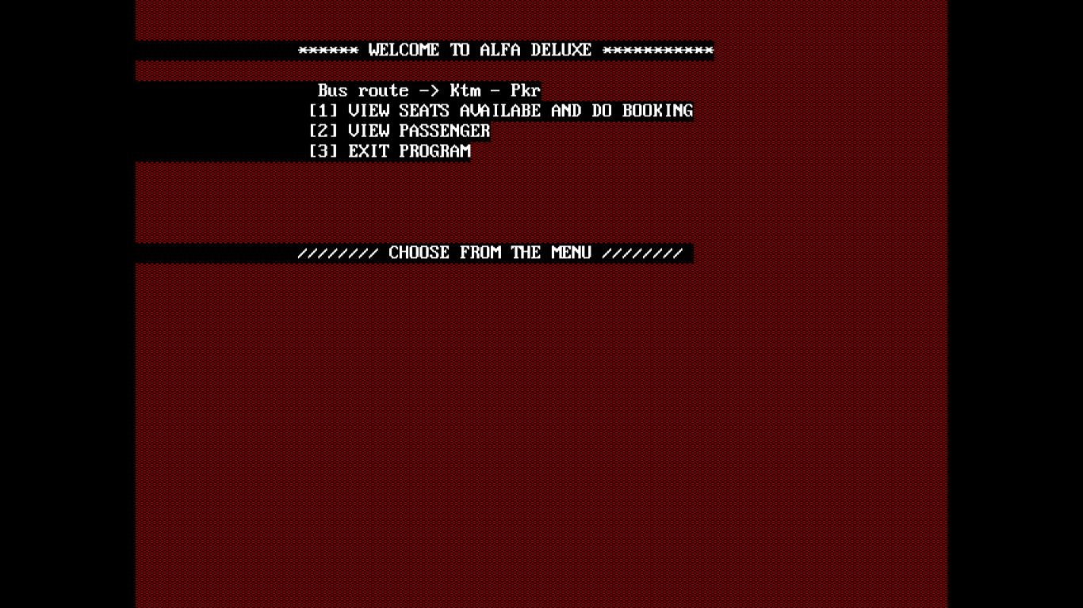
The main menu of the program.

Slide 11
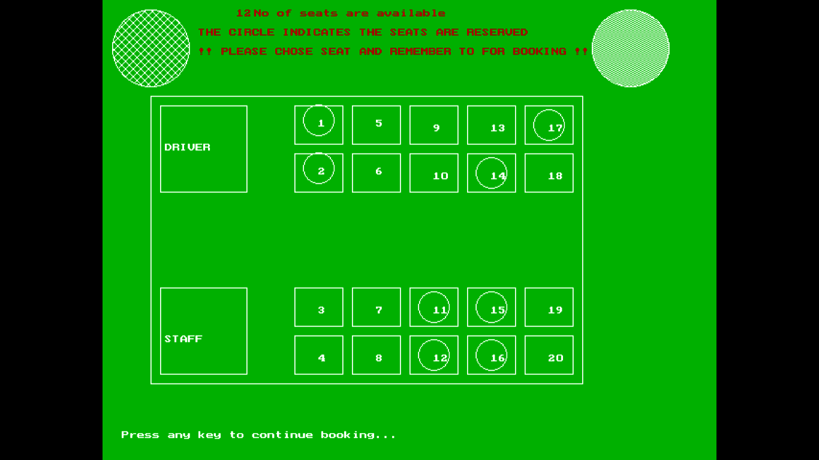
The seat structure shown using graphics function.

Slide 12
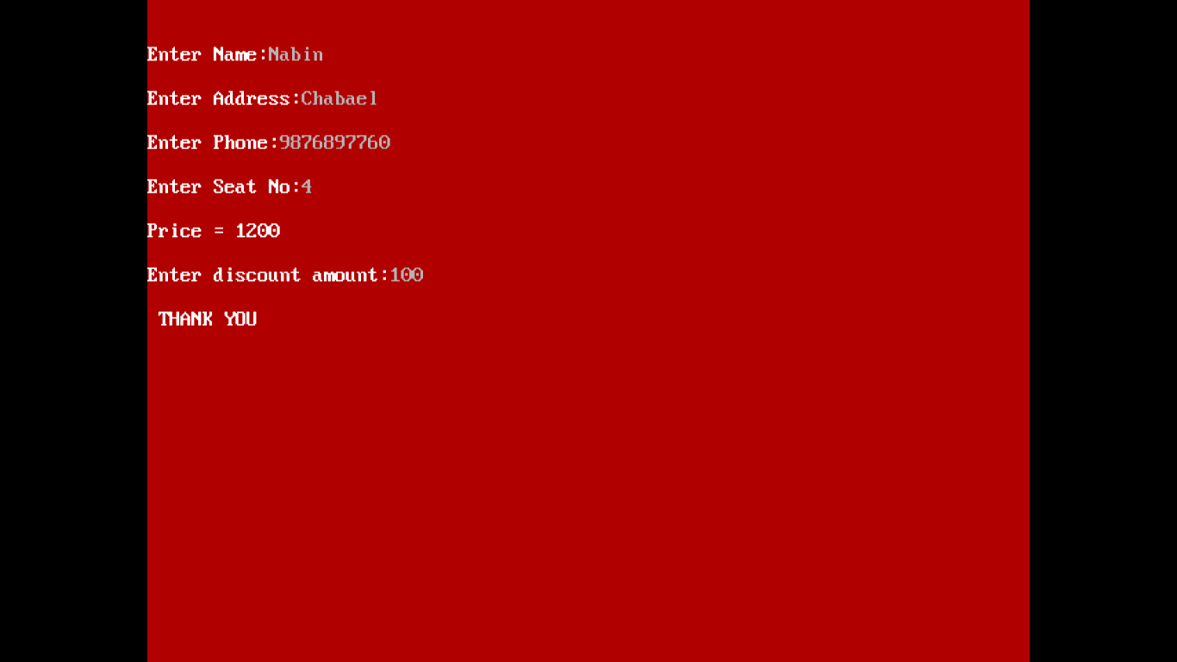
The data entry screen.

Slide 13
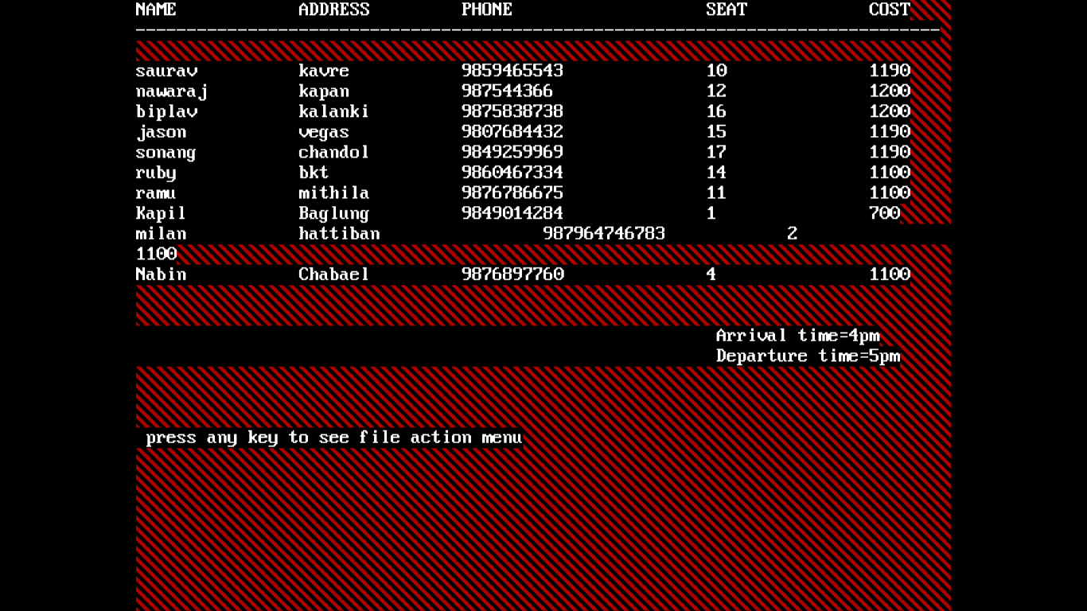
The data view.

Slide 14
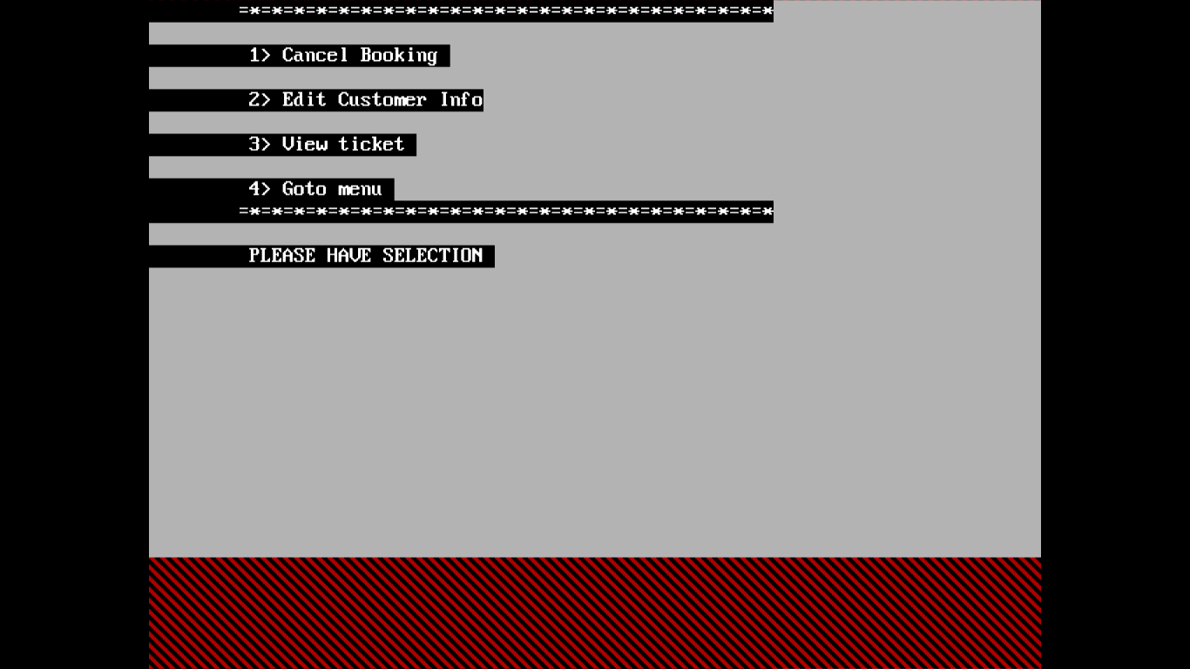
The data action menu after viewing the datas.

Slide 15
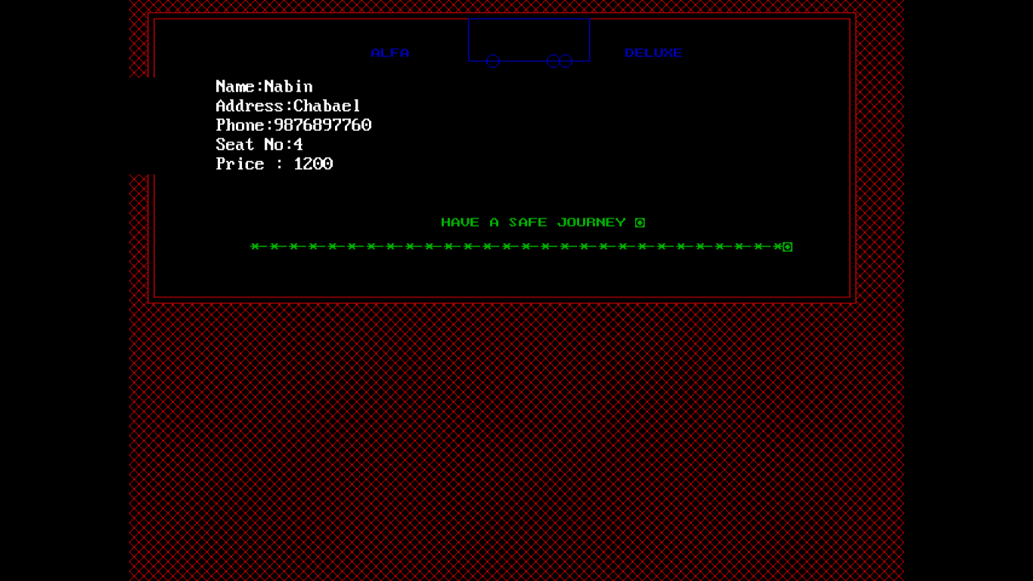
Ticket format view.

Slide 16
Limitations in this system
In this program we have made the data storage for only one route of the bus, but we can also make it for the multiple routes.
The use of graphics is simple.
The use of graphics made a problem of flickering in full-screen mode.

Slide 17
Conclusion
In this way a computerized system can be used to make the bus reservation program in an effective and efficient way.

Slide 18
Reference
Internet
www.programmingsimplified.com/c/graphics.h
Book’s
Teacher’s

Slide 19
QUESTION’S ????

